Slide 1

Bharati Vidyapeeth ’s Jawaharlal Nehru Institute of Technology
“Grocery Store Management System with Recommendation Feature”
Group Members:- 19: Priyansh Chhajed 48: Mufeez Shaikh 49: Aditya Bhosale 52: Pratham Chhajed
Guided by:- Mr. Amol Suryawanshi

Slide 2
CONTENTS
Introduction
Literature Survey
Problem Statement
Objectives and Scope
System Analysis
System Design
Implementation
Test Cases
Future Scope
Conclusion
References

Slide 3
INTRODUCTION
Grocery Store Management System is the system where all the aspects related to the proper management of the grocery store is done.
These aspects involve managing information about the various products, staff, customers, billing etc.
This system provides an efficient way of managing a grocery store information.
This project is based on the sales transaction and billing of items in a grocery store.

Slide 4
LITERATURE SURVEY
A study of inventory management techniques applied by organized retailers’ and its effect on customer satisfaction and retailer’s financial performance with special reference to Bhopal and Indore City
Year-2014
Authors: Dr. Pratyush Tripathi1 and Deepak Tiwari2
Improving Business Performance through Effective Inventory Management
Year- 2015
Authors: Akinola Olakunle
Design and Implementation of Supermarket Management System
Year-2015
Authors: Yongchang Rena , Mengyao Chenb

Slide 5
Grocery retail supply chain planning and control: Impact of consumer trends and enabling technologies
Year- 2018
Authors: Logan R.Vallandingham, QuanYu, NakulSharma, Jo W.Strandhagen,Jan OlaStrandhagen
Smart Goods Billing Management and Payment System
Year- 2018
Author: Jatin Arora

Slide 6
PROBLEM STATEMENT
“Effective management of grocery store for reducing workload on the shopkeeper”
Building a standard grocery store management system was not an easy task looking
at the problems of existing manual system
The factors for these difficulties are:
Time Consumption
Poor Communication
Physical Counts
Daily Purchases
Ordering Supplies

Slide 7
OBJECTIVES
1. To study the functions of grocery store Management System.
2. To explore the challenges being faced by the manual system.
3. To make a software fast in processing, with good user interface.
4. To ensure accurate statistics of product item.
5. For Easy record of goods in store and proper identification.
SCOPE OF STUDY
After the login it provides quick way of operation for the User i.e Shopkeeper or the employees by capturing the manual process like maintaining stocks, billing etc and automating them.
This project is helpful to computerize the item transaction, sales activity record keeping which is a very huge task and maintaining the stock.

Slide 8
SYSTEM ANALYSIS
Purpose
To design a Computerized grocery store Management System ,keep status and updates of Transactions & Stocks available, provide a good Billing System thereby helping shop owners and employees to run the shop smoothly and efficiently.
Intended Audience
The software is developed to manage a grocery store so everyone working in the store and also the customers can use this software. It intendent to give the access of the software to the admin who can add employees which will then give the employees access to the employee login and the customers can anytime place a order.
Functional Requirements
Our system requires the database with all the details about the products, employees, suppliers, etc. This database is updated by the admin which will perform different functions like login, adding items in bill, printing bill, etc.

Slide 9
SOFTWARE AND HARDWARE REQUIREMENTS
Software:
NetBeans
MySQL
Language used:
Java
My SQL
Hardware:
Processor: Intel(R) Core(TM) i3-6006U CPU @ 2.00GHz
Installed Memory(RAM): 4.00 GB
System Type: 64-Bit Operating System, x64 Based Processor

Slide 10
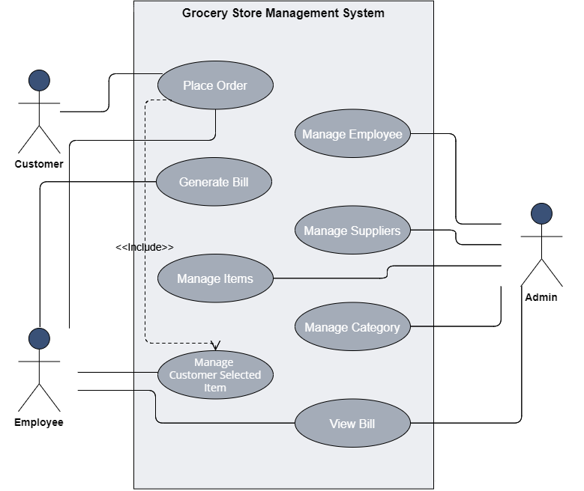
USE CASE DIAGRAM

Slide 11
PROPOSED SYSTEM
ADMIN
EMPLOYEE
CUSTOMER
LOGIN
LOGIN
LOGIN
MANAGE ITEMS DETAILS
MANAGE EMPLOYEES DETAILS
MANAGE SUPPLIERS DETAILS
ADD ITEMS
UPDATE ITEMS
ADD EMPLOYEE
UPDATE EMPLOYEE
MANAGE CATEGORY DETAILS
SET RECOMMENDATIONS
ADD SUPPLIER
UPDATE SUPPLIER
DELETE SUPPLIER
ADD CATEGORY
UPDATE CATEGORY
DELETE CATEGORY
VIEW BILLS
DELETE EMPLOYEE
DELETE ITEMS
SEARCH ITEMS
ADD ITEMS
GENERATE BILL
CALCULATE TOTAL
PRINT BILL
SAVE BILL
CHECK FOR ODER FROM CUSTOMER LOGIN
ADD ITEMS
SEARCH ITEMS
ADD ITEMS
PLACE ORDER
DATABASE

Slide 12

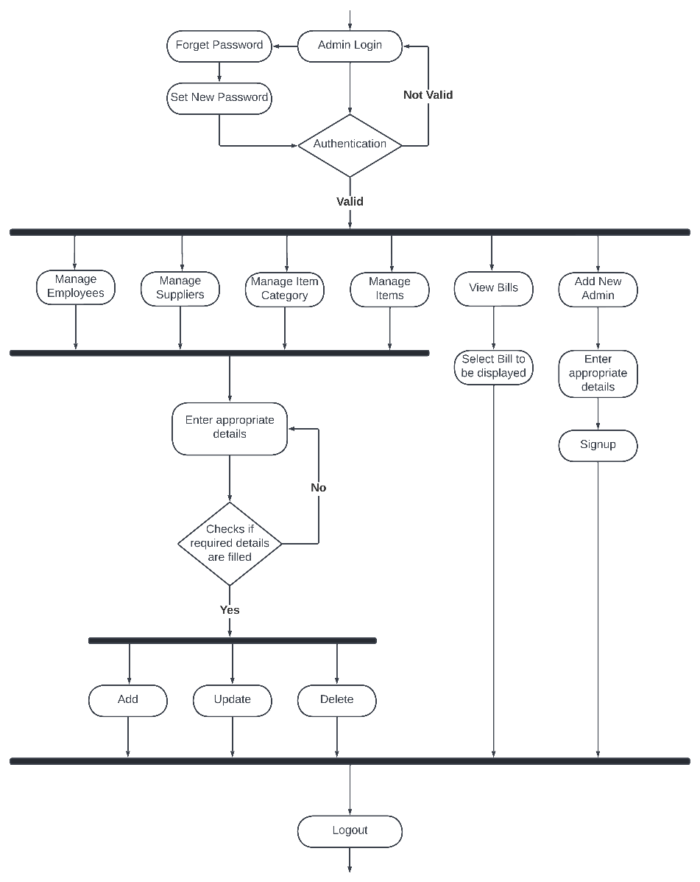
ACTIVITY DIAGRAM

Slide 13
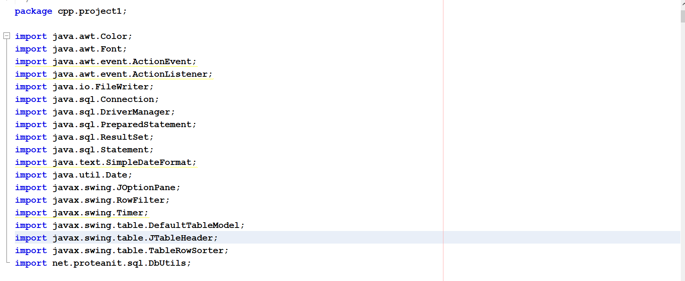
CODE
Packages

Slide 14
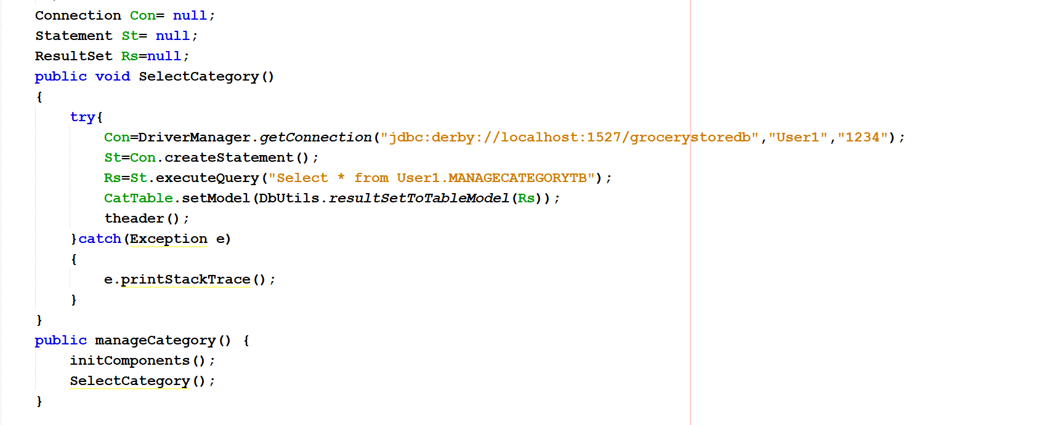
Statements in code used to connect Database to the system

Slide 15
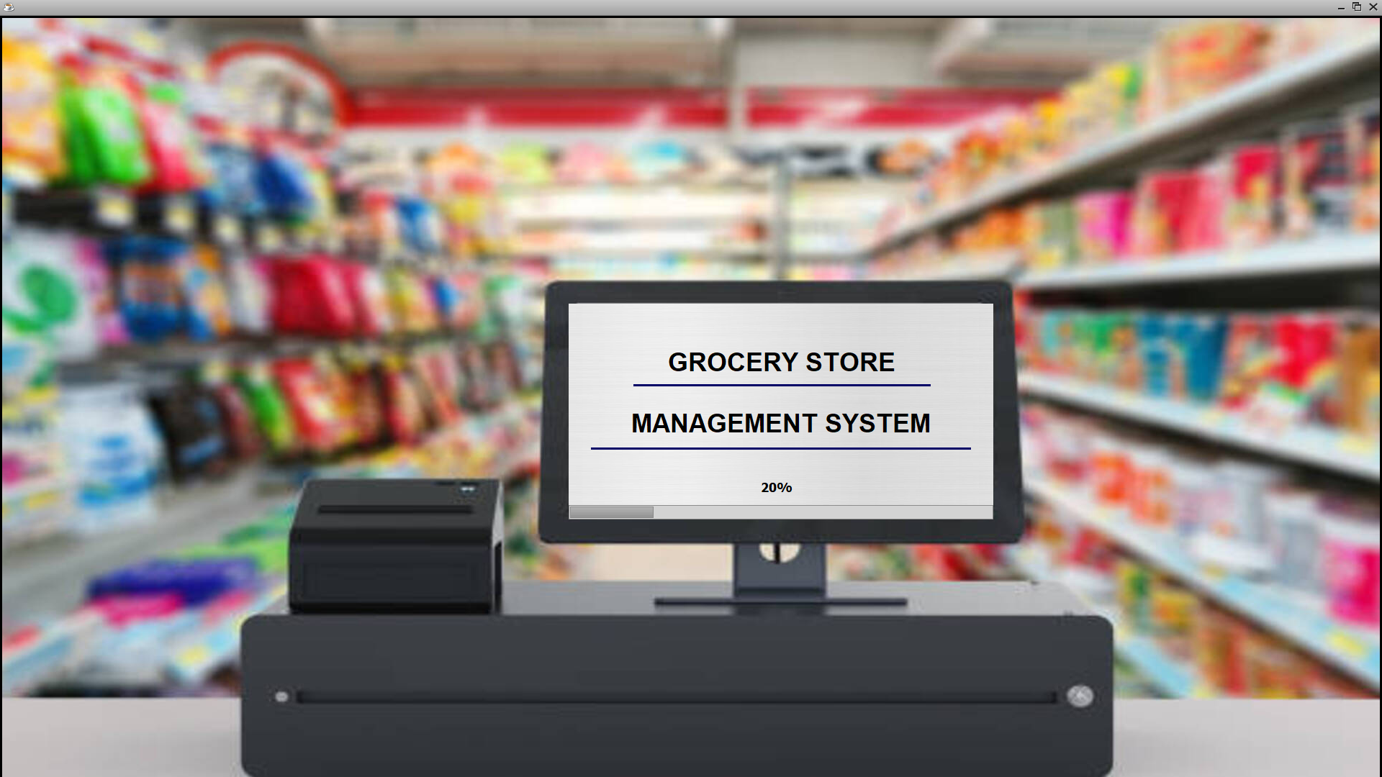
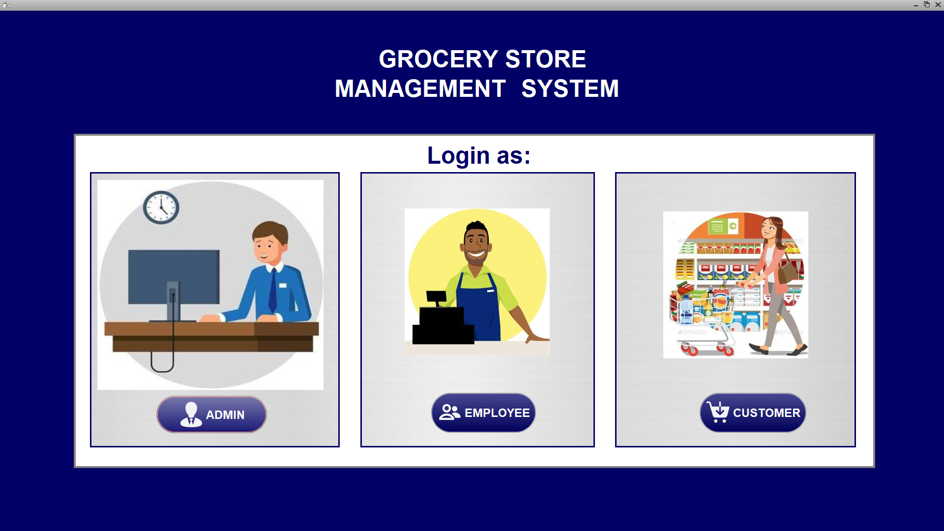
OUTPUTS
Start Page
Login Page

Slide 16
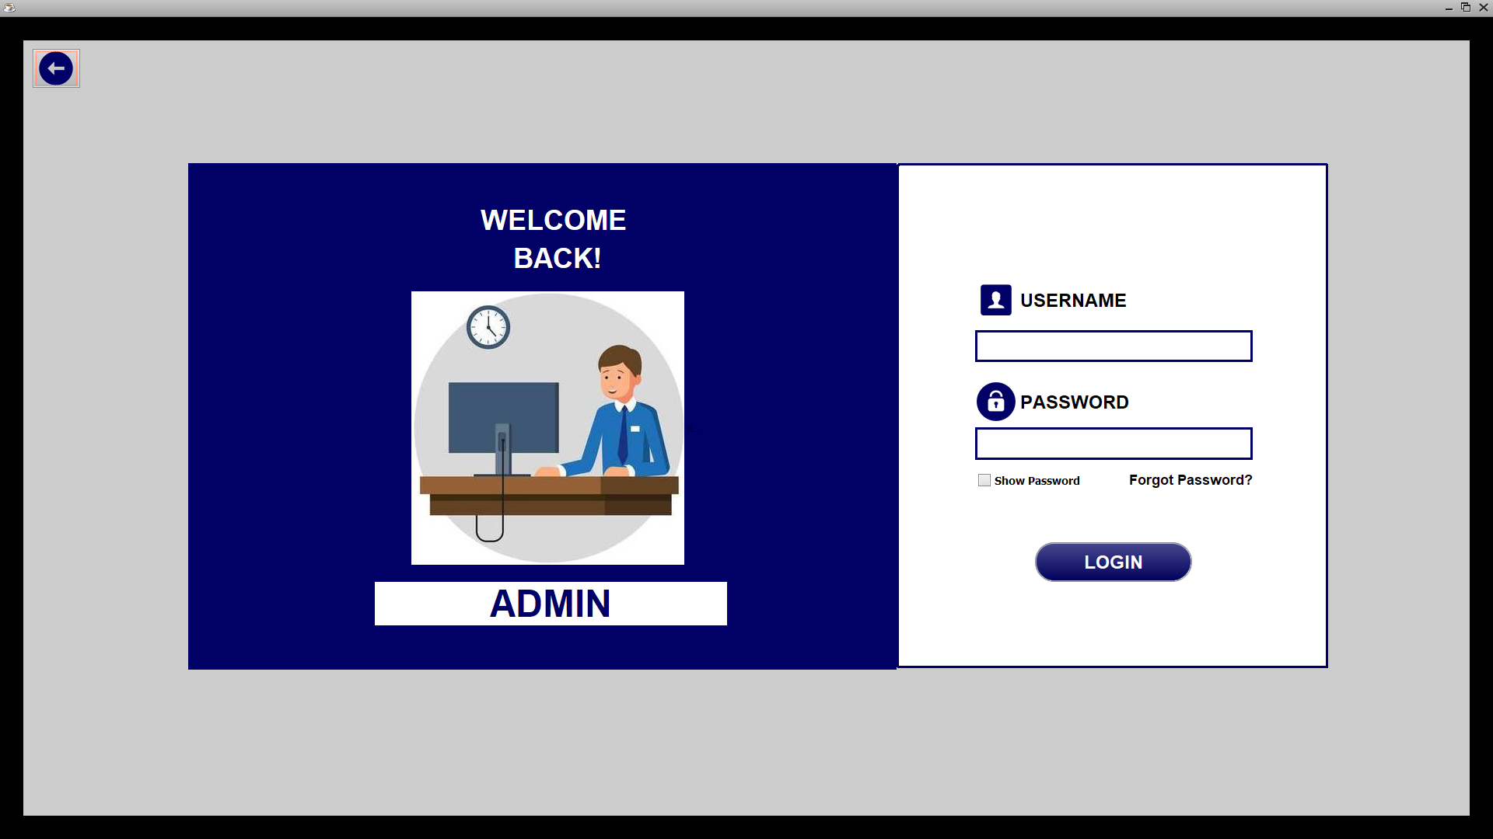
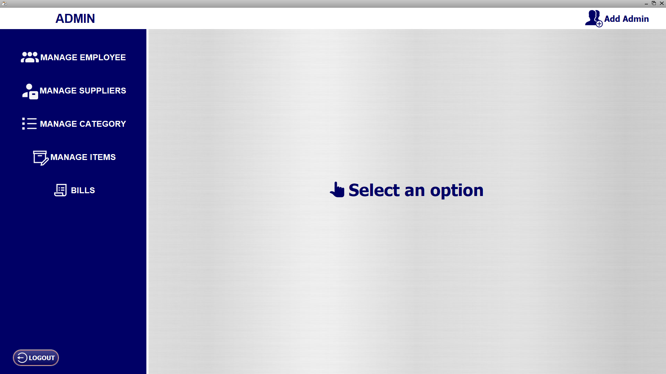
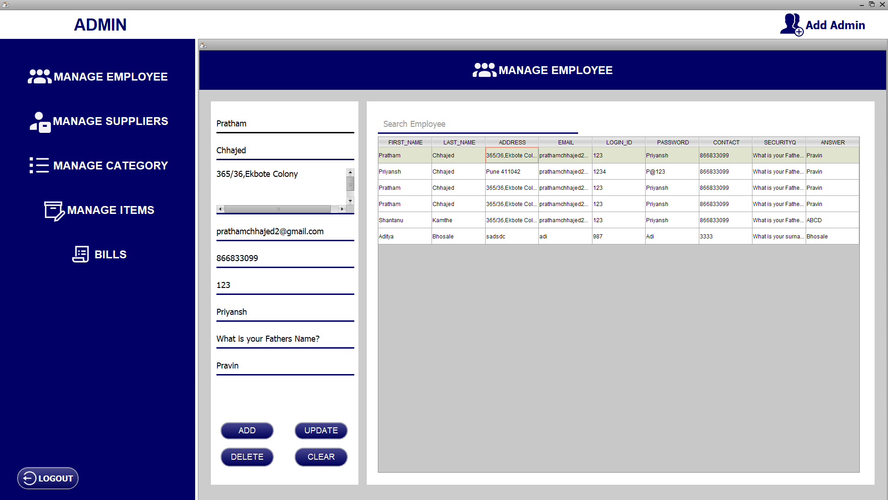
Admin Login
Admin Main Page
Admin Manage Employee option

Slide 17
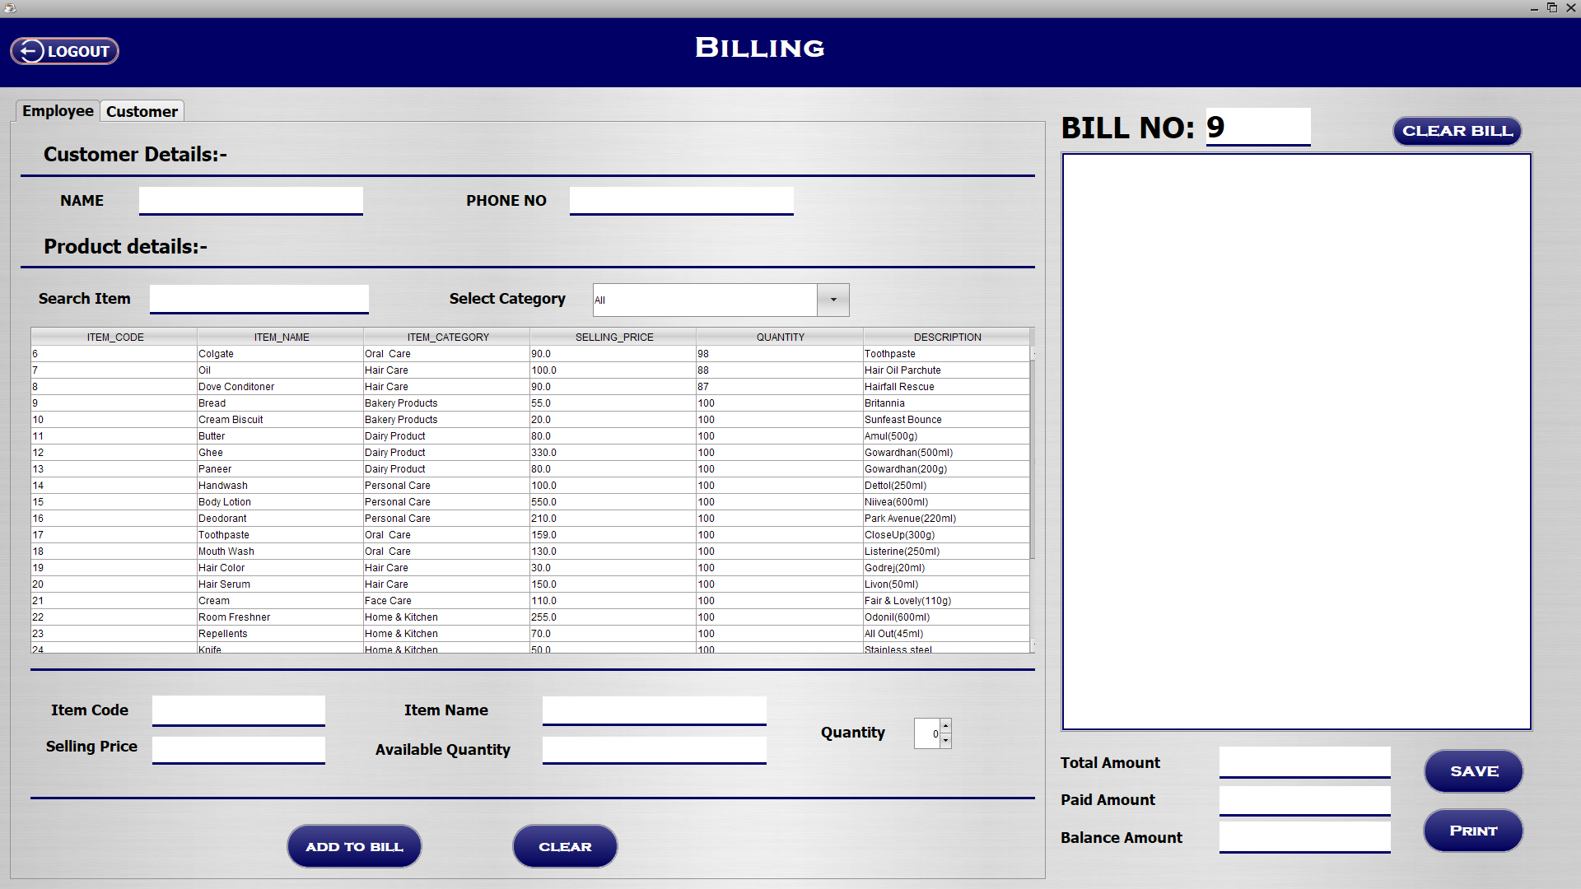
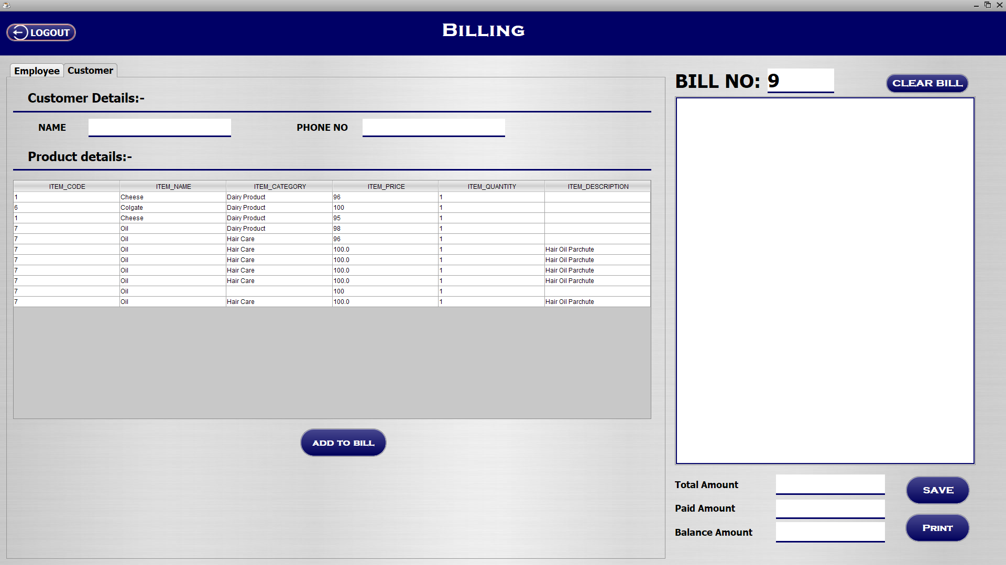
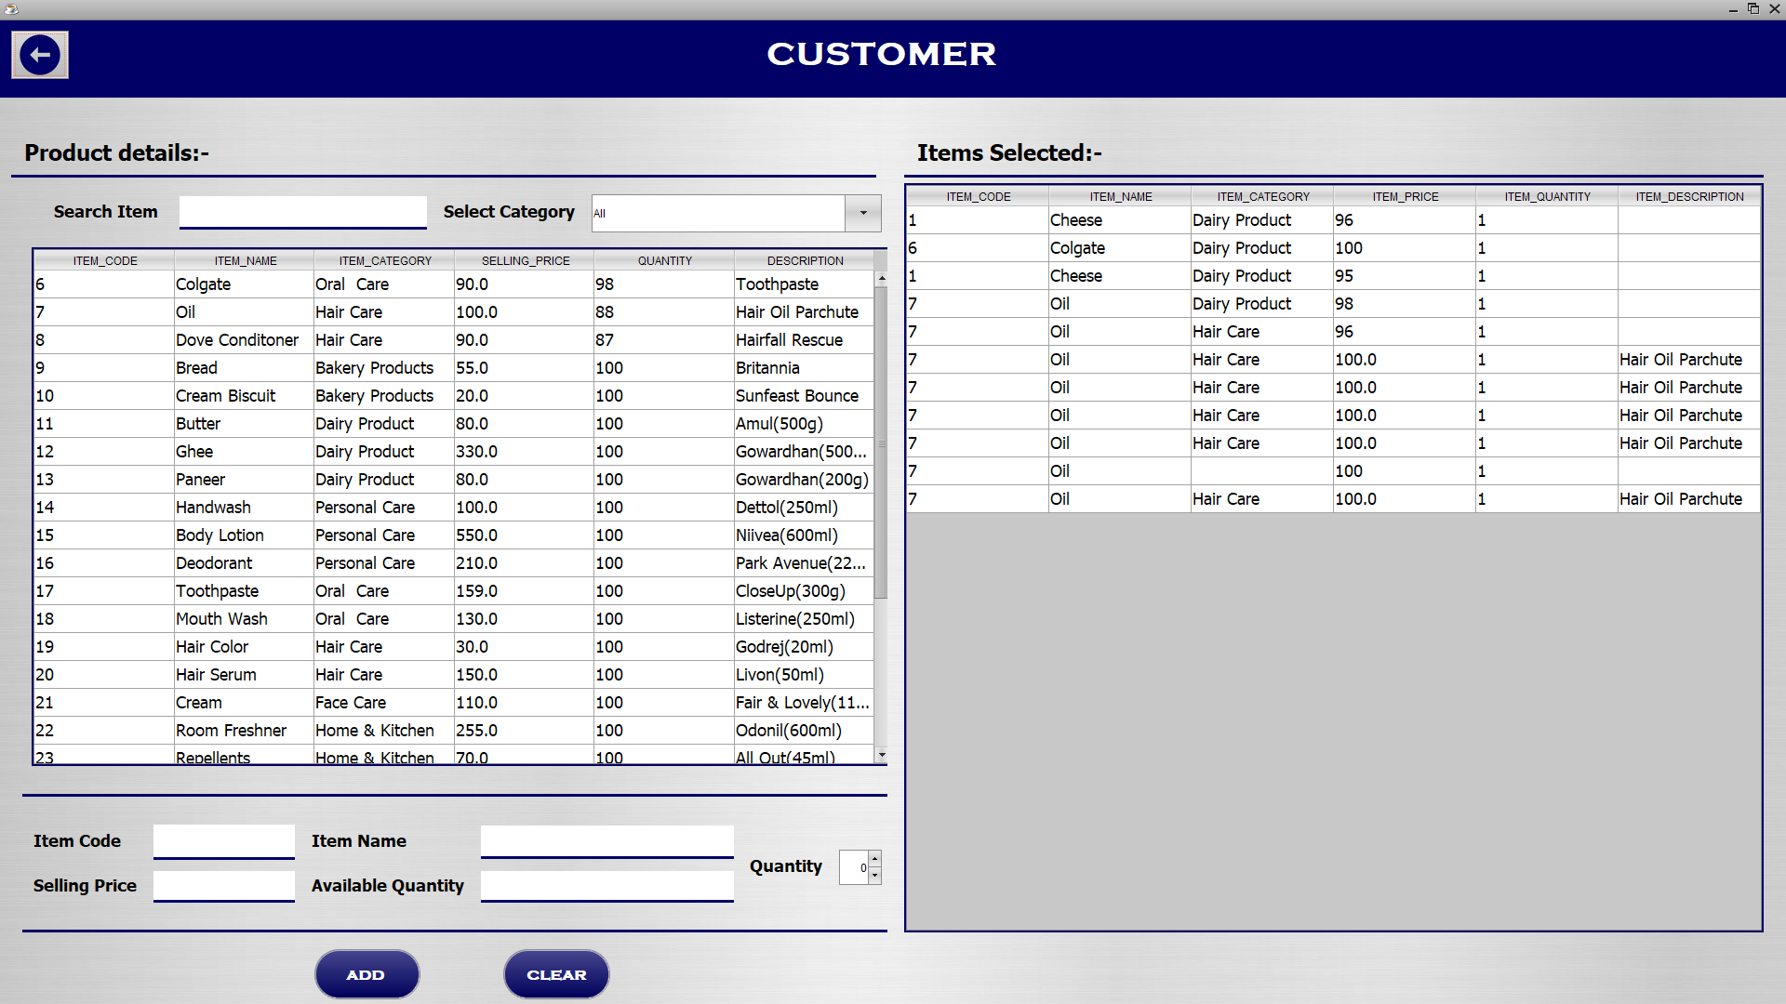
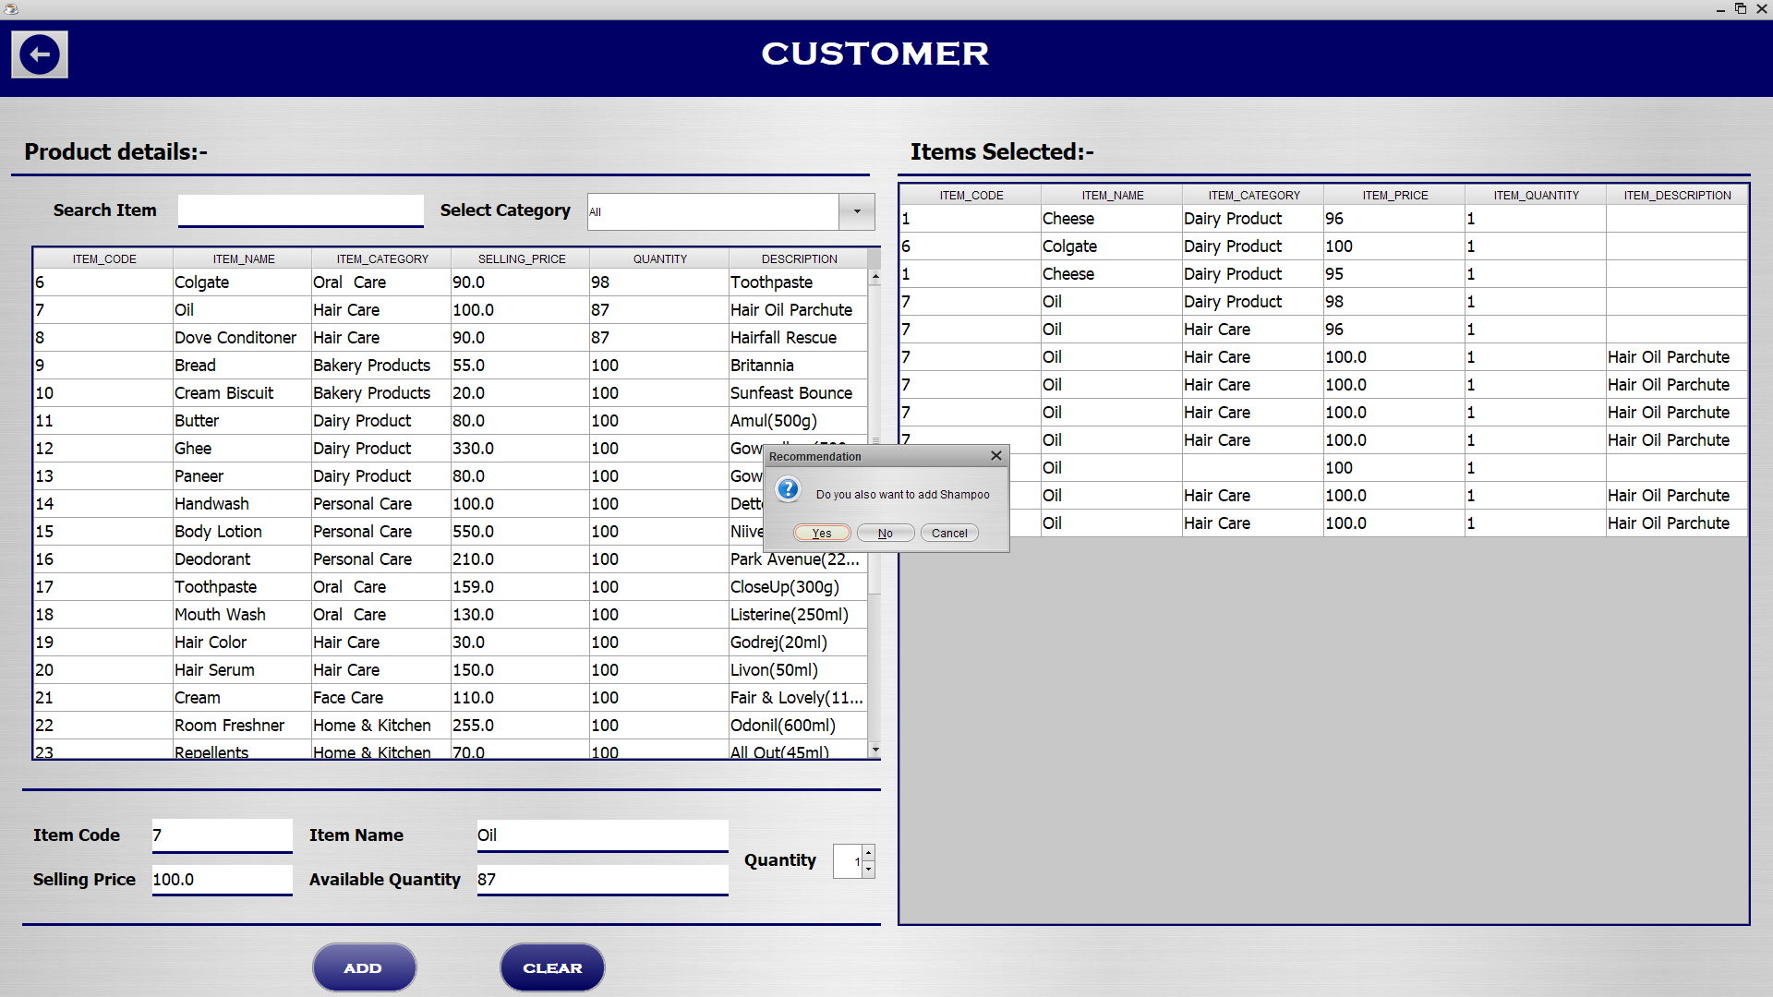
Employee Main Page-Billing
Billing- Customers order
Customer Login
Recommendation Window

Slide 18
TEST CASES
Admin User-
Test Case ID | Test Scenario | Requirement | Expected Result | Actual Result
TC_1 | Perform Grocery Store Management System by checking valid Username and Password for Admin. | Admin Username and Password. | Admin must be logged in successfully. | The username and password are correct means the admin has successfully logged in.
TC_2 | Perform Grocery Store Management System by checking valid Username and Password for Admin. | Admin Username and Password. | Admin must be logged in successfully. | The username and password are incorrect means the admin has not successfully logged in.

Slide 19
Test Case ID | Test Scenario | Requirement | Expected Result | Actual Result
TC_3 | Perform Grocery Store Management System by verifying that the 'Add' button is working successfully. | All the input fields should be filled. | After clicking on the 'Add' button, the data should be added to the specified location. | The data was added to the specified location.
TC_4 | Perform Grocery Store Management System by verifying that the 'Update' button is working successfully. | All the input fields should be filled. | After clicking the 'Update' button, the specified location data should be updated. | The data was updated to the specified location.
TC_5 | Perform Grocery Store Management System by verifying that the 'Delete' button is working successfully. | All the input fields should be filled. | After clicking the 'Delete' button, the specified location data should be deleted. | The data at the specified location was deleted.
TC_6 | Perform Grocery Store Management System by verifying that the 'Clear' button is working successfully. | All the input fields should be filled. | After clicking the "Clear" button, all input fields should be cleared. | All input fields cleared.

Slide 20
Employee User-
Test Case ID | Test Scenario | Requirement | Expected Result | Actual Result
TC_7 | Perform Grocery Store Management System by checking valid Username and Password for Employee. | Employee Username and Password. | Employees must be logged in successfully. | The username and password are correct means the employee has successfully logged in.
TC_8 | Perform Grocery Store Management System by checking valid Username and Password for Employee. | Employee Username and Password. | Employees must be logged in successfully. | The username and password are incorrect means the employee has not successfully logged in.

Slide 21
Test Case ID | Test Scenario | Requirement | Expected Result | Actual Result
TC_9 | Perform Grocery Store Management System by verifying that the 'Add to Bill' button is working successfully. | All the input fields should be filled. | After clicking on the 'Add to Bill' button, the data should be added to the bill. | The data was added to the bill.
TC_10 | Perform Grocery Store Management System by verifying that the 'Clear' button is working successfully. | All the input fields should be filled. | After clicking the "Clear" button, all input fields should be cleared. | All input fields cleared.
TC_11 | Perform Grocery Store Management System by verifying that the 'Save' button is working successfully. | All the input fields should be filled. | After clicking the 'Save' button, the bill should be saved on the computer. | The bill was saved on the computer.
TC_12 | Perform Grocery Store Management System by verifying that the 'Print' button is working successfully. | All the input fields should be filled. | After clicking on the 'Print' button, the Print dialog box should open, and then the bill should be printed. | The Print dialog box opened and the bill was printed successfully.
TC_13 | Perform Grocery Store Management System by verifying that the 'Clear Bill' button is working successfully. | All the input fields should be filled. | After clicking on the 'Clear Bill' button, the bill should be cleared. | The bill was cleared.

Slide 22
Customer User-
Test Case ID | Test Scenario | Requirement | Expected Result | Actual Result
TC_9 | Perform Grocery Store Management System by verifying that the 'Add to Bill' button is working successfully. | All the input fields should be filled. | After clicking on the 'Add to Bill' button, the data should be added to the bill. | The data was added to the bill.
TC_10 | Perform Grocery Store Management System by verifying that the 'Clear' button is working successfully. | All the input fields should be filled. | After clicking the "Clear" button, all input fields should be cleared. | All input fields cleared.

Slide 23
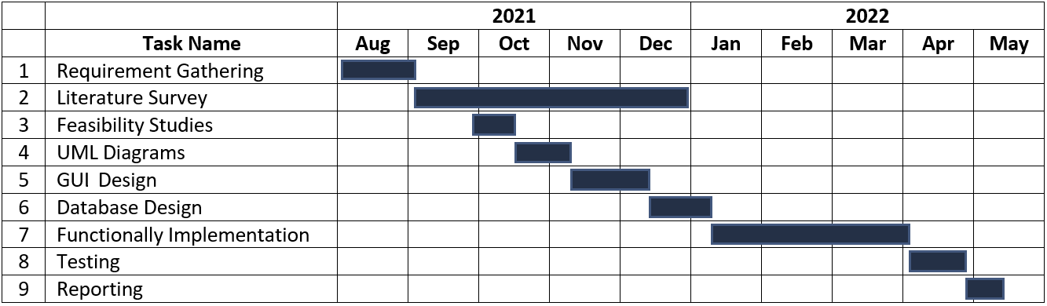
GANTT CHART

Slide 24
FUTURE SCOPE
Our system has some limitations where all the 3 users which are Admin, Employee, and Customer, cannot use the system simultaneously.
But using networking it can be made possible which can make the management and billing work faster.
In our system recommendation of the products is handled by admin, but we can use ML, where if provided the database the system can provide recommendation on its own.
Also, this Grocery Store Management System can be used for managing other stores too if appropriate changes are done in the system.

Slide 25
CONCLUSION
With business opportunities increasing as never before , companies are in direct need of efficient management.
One such key area is to maintain a methodical way of managing large databases , especially in the Retail Sector.
DBMS is a vital tool for future growth of business organization.
It offers a simple, efficient and reliable way of storing , managing and accessing data.

Slide 26
References
https://www.google.co.in
https://scholar.google.com
https://www.youtube.com
A study of inventory management techniques applied by organized retailers’ and its effect on customer satisfaction and retailer’s financial performance with special reference to Bhopal and Indore City https://citeseerx.ist.psu.edu/viewdoc/download?doi=10.1.1.672.5673&rep=rep1&type=pdf
Improving Business Performance through Effective Inventory Management https://www.researchgate.net/publication/317350268
Design and Implementation of Supermarket Management System https://www.atlantis-press.com/article/25844825.pdf
Grocery retail supply chain planning and control: Impact of consumer trends and enabling technologies https://www.sciencedirect.com/science/article/pii/S24058963183151181971
Smart Goods Billing Management and Payment System
https://www.researchgate.net/publication/325499919

Slide 27
THANK YOU!

